Slide 1
Malpositions and Malpresentations
Sanjeewa Padumadasa

Slide 2
Presentation of the fetus
Leading part of the fetus in relation to the pelvic brim
Normal presentation in cephalic presentation is vertex presentation
Vertex is the area of the fetal head surrounded by the two fontanellae and the two parietal eminences

Slide 3
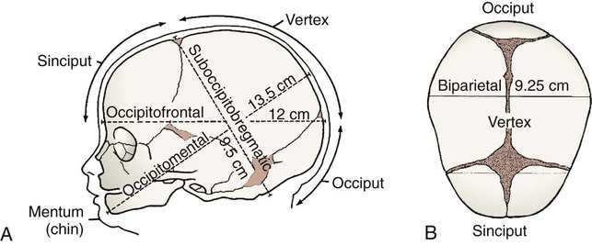
Vertex and the presenting diameters of the fetal head

Slide 4
Position of the fetal presenting part
Position of the fetal presenting part is the relationship of the presenting part of the fetus to the maternal pelvis
The denominator or the reference point of the presenting part is the
  Occiput in cephalic presentation
  Sacrum of the fetus in breech presentation
Normal position is occipito anterior position
  Commonly LOA

Slide 5
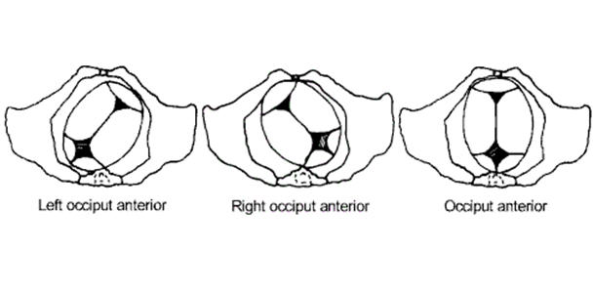
Occipito-anterior position

Slide 6
Malpositions
A position other than normal position is called malposition
  Occipito posterior position in cephalic presentation
  Sacro posterior position in breech presentation
Can lead to prolonged labour and thus the partogram will be abnormal

Slide 7
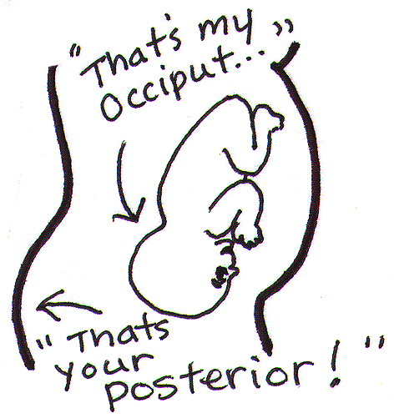
Occipito-posterior position

Slide 8
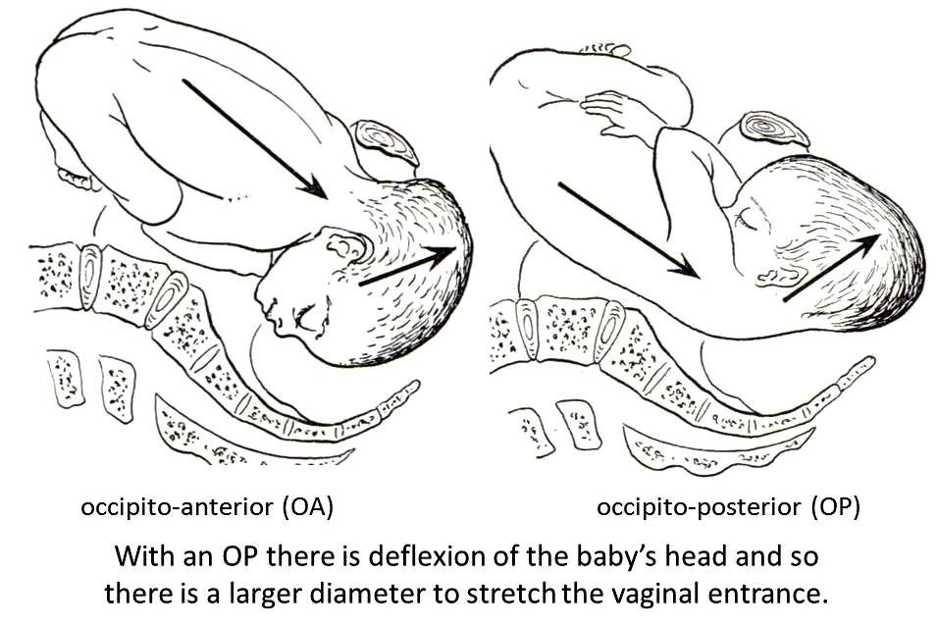
Occipito-posterior position

Slide 9
Occipito posterior position
Common in primigravidae
Associated with anthropoid & android pelvis
Anterior wall placenta
Maternal anterior abdominal wall muscle tone
  Increased tone is in favor of this position – Primi

Slide 10
OPP – Abdominal findings
Head is not engaged
Head is deflexed
Occiput and the synciput are at the same level
Fetal back is laterally or posteriorly placed
Fetal limbs are easily palpable
Flattening of the supra pubic area
Fetal heart sounds are faint

Slide 11
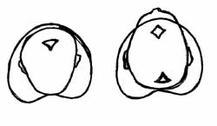
OPP Vaginal examination in labour
Anterior fontanelle is placed anteriorly and easy to palpate
Posterior fontanelle is placed posteriorly
Can palpate both fontanellae due to deflexion of the head
Fetal ear – Abnormal position

Slide 12
OPP - In Labour
About 2/3rd will rotate into occipito anterior position
Few will become direct OPP & deliver as a face to pubes
Deep Transverse arrest
Secondary Brow or Secondary Face presentation

Slide 13
Direct OPP – Treatment
Can be delivered as face to pubes
Traction Forceps or ventouse when there is delay
Rotational forceps - Kjelland’s forceps
Caesarean section if there is CPD or problems in the first stage

Slide 14
Deep transverse arrest – Treatment
The head is arrested in occipito lateral position
Manual rotation + / - traction forceps
Ventouse
Rotational forceps
Caesarean section

Slide 15
Malpresentations
Presentation which is other than cephalic is called malpresentation
Primary face and brow presentation
Shoulder presentation
Dorsal presentation
“Cord presentation”
Breech presentation

Slide 16
Face and brow presentations
Primary brow and face share the same aetiological factors
Permanent extension of the fetal neck
due to cervical spine deformities, goitre, hygroma, branchial cysts etc.

Slide 17
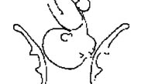
Brow presentation
Due to extension of the fetal head
Effective diameter of the fetal head is mento vertical diameter
This is the largest diameter of the fetal head and in a term fetus measures 13.5 cm
Caesarean section is required

Slide 18
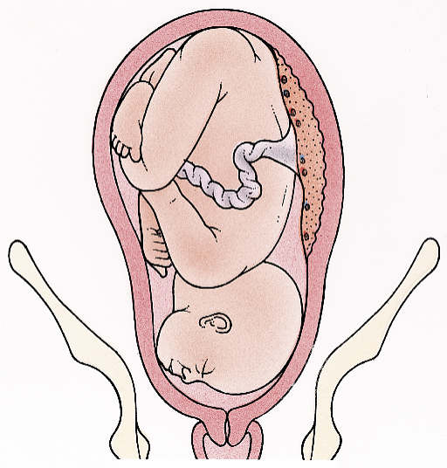
Brow presentation

Slide 19
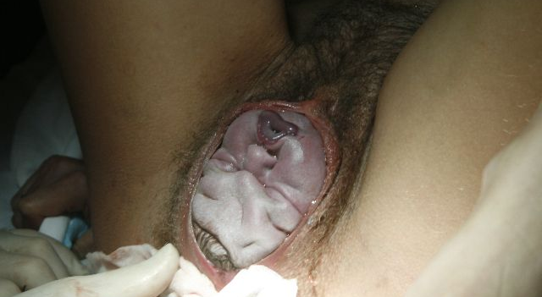
Face presentation
Due to extension of the fetal head
Effective diameter is sub mento bregmatic diameter which is 9.5 cm
Usually mento anterior position
Can be delivered vaginally
Ventouse cannot be applied

Slide 20
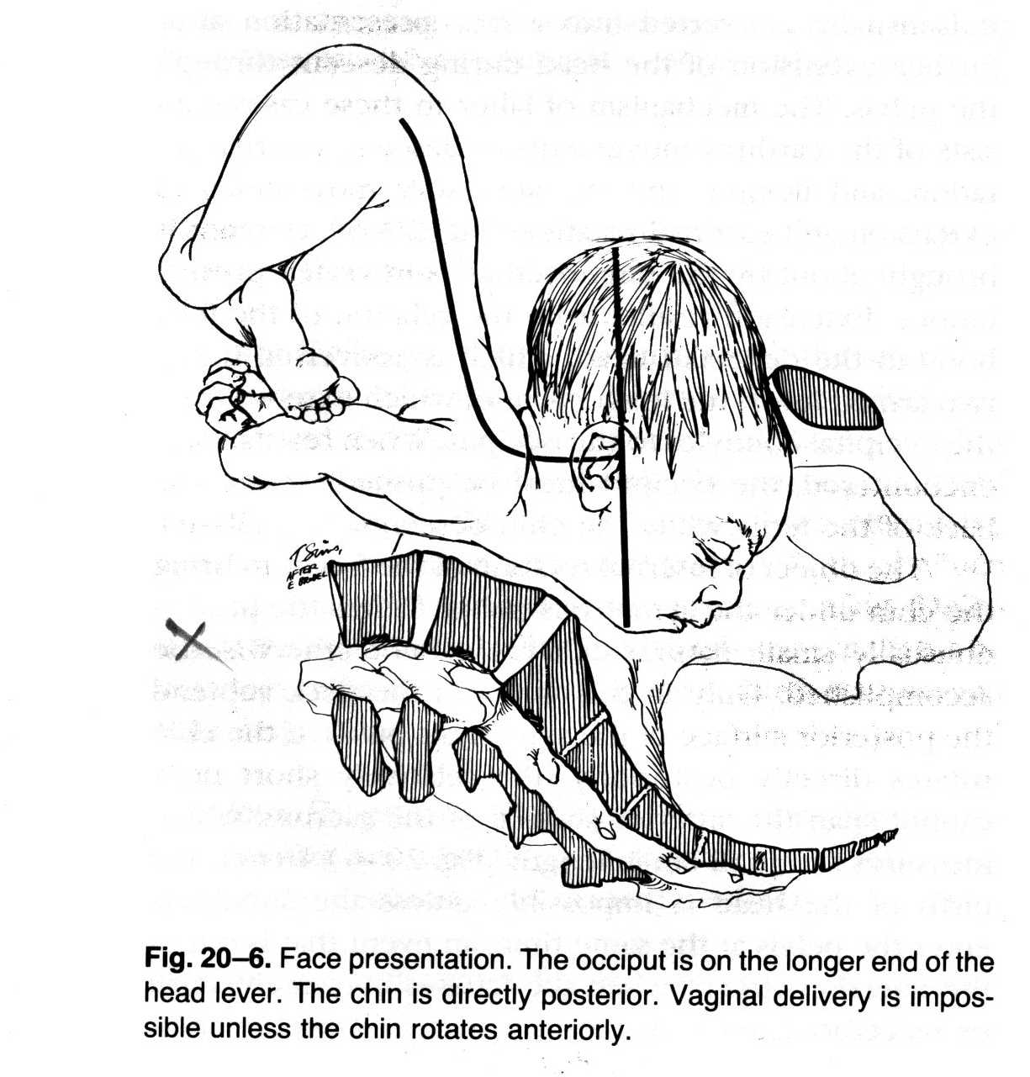
Mento-posterior face presentation

Slide 21
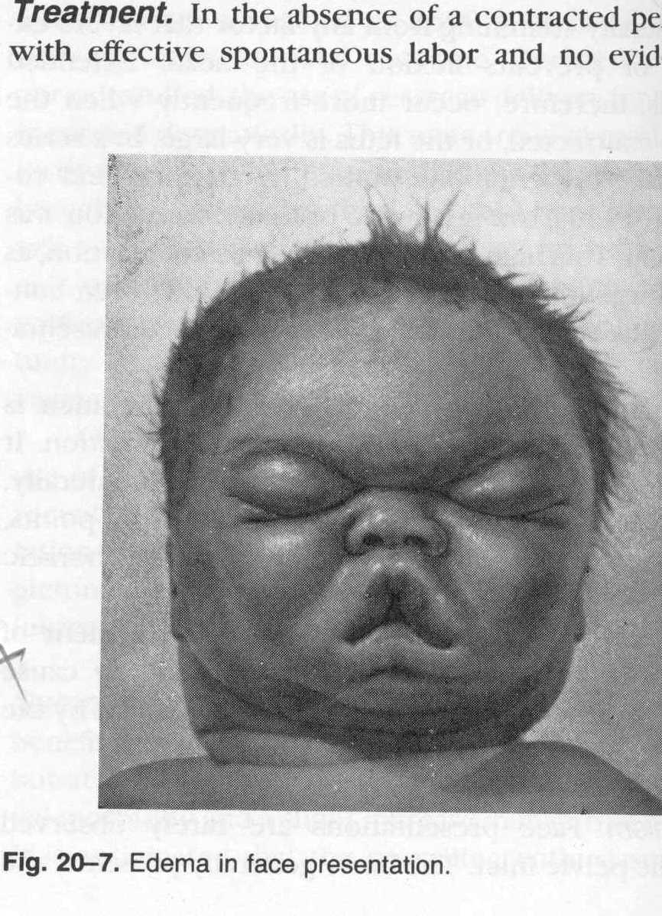
Oedema in face presentation – Usually resolves within 24 hrs

Slide 22
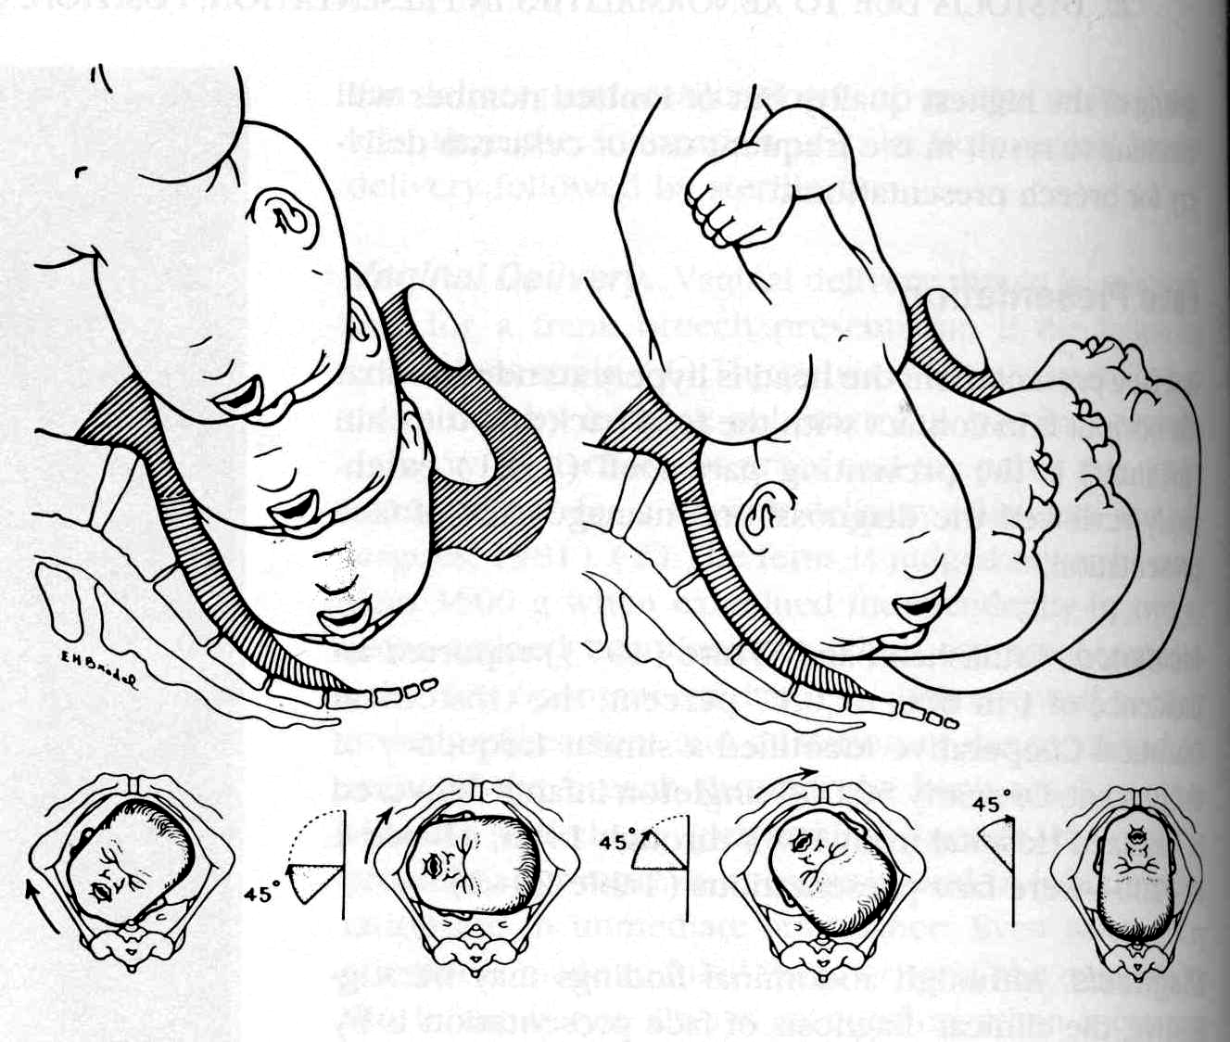

Slide 23
Sacro posterior position in breech presentation
This must be avoided during vaginal breech delivery
Delivery of the after coming head is difficult as it will be in an occipito-posterior position

Slide 24
Shoulder and dorsal presentations
Seen with transverse and oblique lie
Can lead to hand prolapse and cord prolapse
External cephalic version if there are no contra indications such as placenta praevia
Elective caesarean section

Slide 25
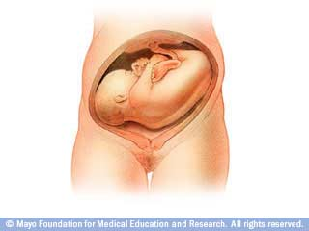
Shoulder presentation

Slide 26
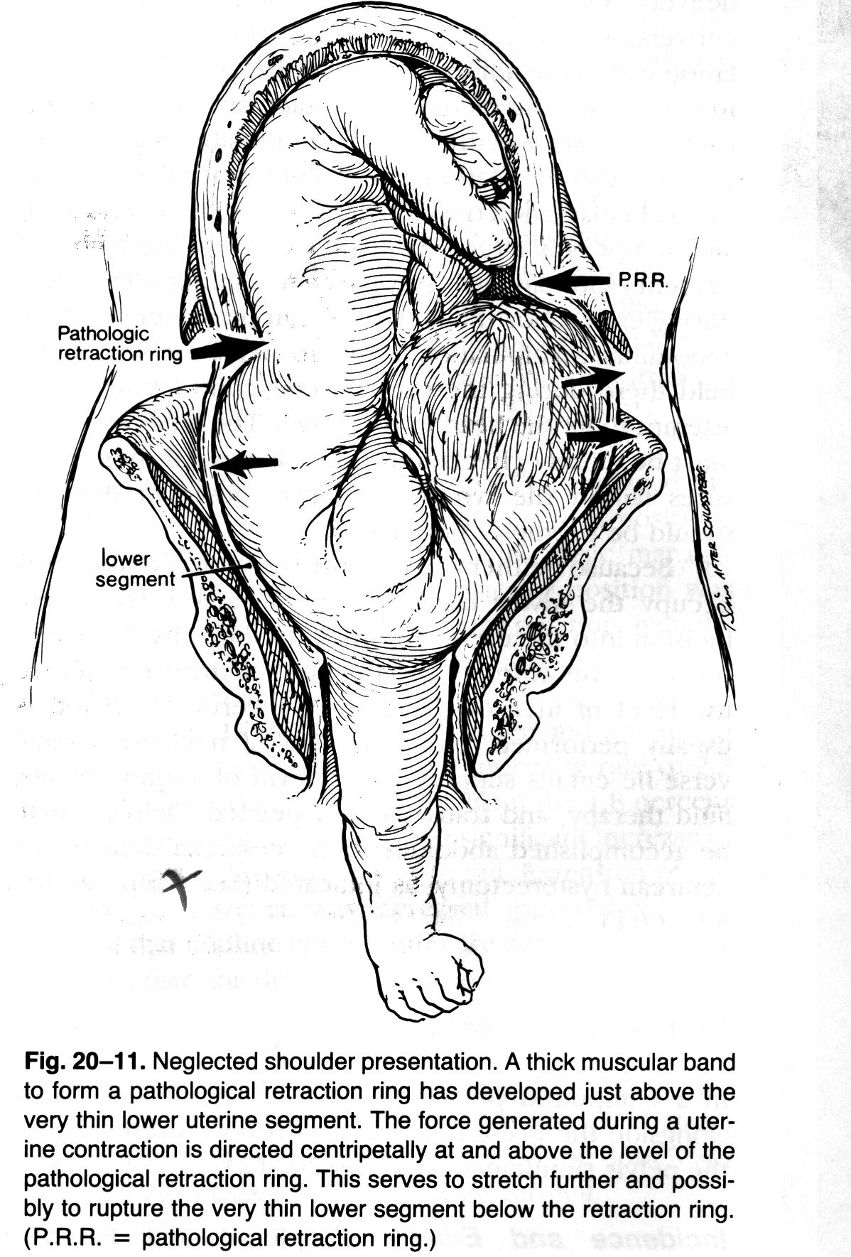
Neglected shoulder presentation
A thick muscular band to form a pathological retraction ring has developed just above the very thin lower uterine segment
The force generated during a uterine contraction is directed centripetally at and above the level of the pathological retraction ring
This serves to stretch further and possibly to rupture the very thin lower segment below the retraction ring
(P.R.R. = pathological retraction ring)

Slide 27
Cord presentation
Presence of the umbilical cord in front of the presenting part with intact membranes
Should be excluded before amniotomy by feeling for the cord pulsation
Can lead to cord prolapse
Emergency caesarean section should be carried out if immediate vaginal delivery is not possible
  Prolapse in 1st stage – Caesarean section
  Prolapse in 2nd stage – Instrumental delivery within 2-3 mins

Slide 28
Breech presentation
Commonest malpresentation
  When the fetal buttocks occupy the lower part of the uterus
2-3 % after 37 weeks
Much higher incidence among preterm babies
Normally the smaller head settles in the lower segment and the moving lower limbs with the trunk occupy the larger upper segment

Slide 29
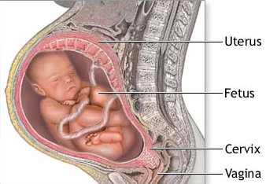

Slide 30
Breech presentation
Increased perinatal mortality and morbidity
  Vaginal breech delivery
  Abnormalities
  Prematurity

Slide 31
Breech – Predisposing factors
Placental - Placenta praevia
Uterine - Bicornuate uterus, Fibroids
Fetal – Hydrocephalus, other abnormalities
Amniotic fluid - Polyhydramnios
Maternal - Inadequate maternal pelvis
Fetal death, Prematurity
Idiopathic
Multiple pregnancy

Slide 32
Types of breech
Extended breech - Frank breech in primigravidae
  50–70%
  Hips flexed, knees extended
Flexed breech - Complete or full breech
  5–10%
  Hips flexed, knees flexed
Footling/Incomplete breech
  10-30%
  One or both hips extended
  Foot presenting

Slide 33
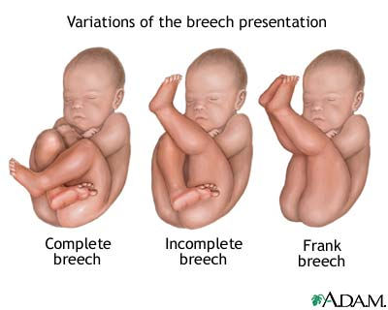

Slide 34
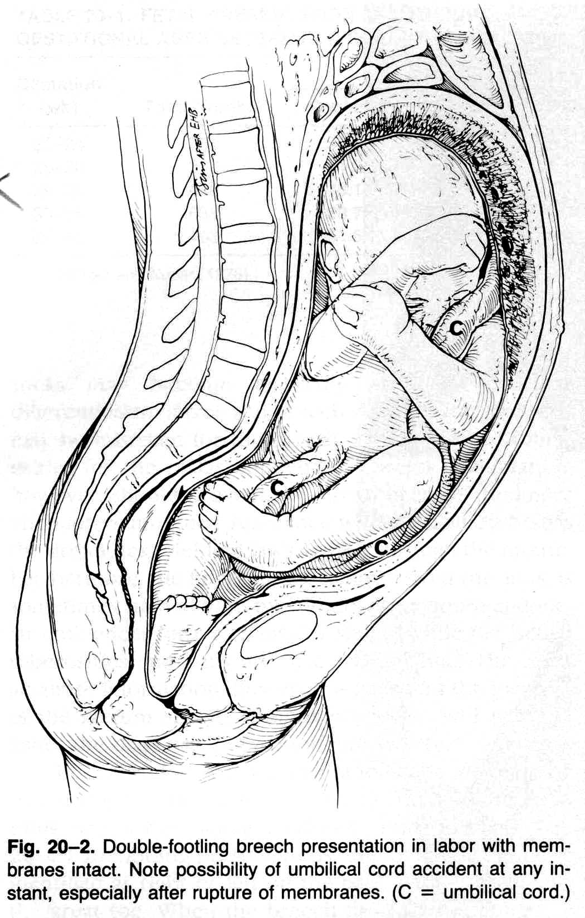
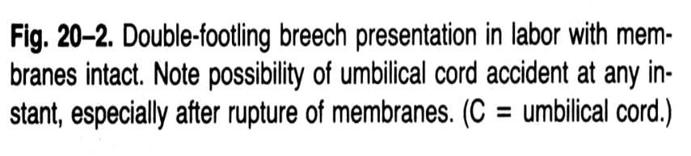

Slide 35
Management of breech
External cephalic version
  This should be offered at 36-37 weeks under ultrasound guidance
  Baby is gently manipulated into cephalic presentation
Exclude factors that preclude vaginal delivery
Other obstetric complications
Exclude fetal anomalies
Assisted vaginal breech delivery or elective caesarean section

Slide 36
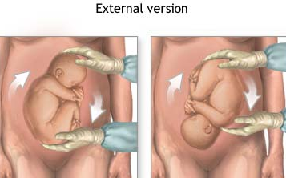

Slide 37
Contraindications to ECV
Pre eclampsia
Previous scar on the uterus
Multiple pregnancy
Fetal abnormality
Placenta praevia
Oligo/polyhydroamniosis
History of ante partum haemorrhage

Slide 38
Vaginal delivery of breech
Decide on the mode of delivery antenatally
  Spontaneous breech delivery
  Assisted vaginal breech delivery
  Total breech extraction
Adequate pelvis
Size of the fetus
Type of breech - Extended legs
Trained staff

Slide 39
Assisted Breech delivery
Type of breech
Maintain a partogram
Experienced staff member to assess patient
Adequate analgesia
Do not hesitate to revise decision
Inform paediatrician
Be prepared for emergency caesarean section

Slide 40
Indications for caesarean section in breech presentation
Feto-pelvic disproportion
Elderly primi
Subfertile primi
Past section
Footling breech
Placenta praevia
Intra uterine growth restriction
Twin pregnancy

Slide 41
Complications of breech presentation
Preterm rupture of membranes
Cord prolapse
Intra cranial haemorrhage
Erb’s paralysis
Rupture of a viscus (Liver, Kidney)
Dislocation of shoulder
Clavicular fracture
Dislocation of hip joint

